Slide 1
Shopping Cart API Specification
A Restful API specification for a shopping purpose.

Slide 2
API specification and Design
This RAML specification defines endpoints for shopping cart operations:
Create new shopping cart
Find shopping cart by ID
Update shopping cart by ID
Delete shopping cart by ID
This API serves as a design best practice to work with APIs like Salesforce via a set of RESTful services that are designed in RAML, making it easily consumable by any developer within the enterprise. This RAML API specification is part of the Accelerator for Salesforce B2C Commerce Cloud and the Accelerator for Retail.
This API depends on the Retail Shopping Cart Types RAML fragment.
Defined types:
ShoppingCartCollectionResponse - Defined shopping cart collection response.
ShoppingCartResponse - Defined shopping cart response.
MessageResponse - Defined message response.

Slide 3
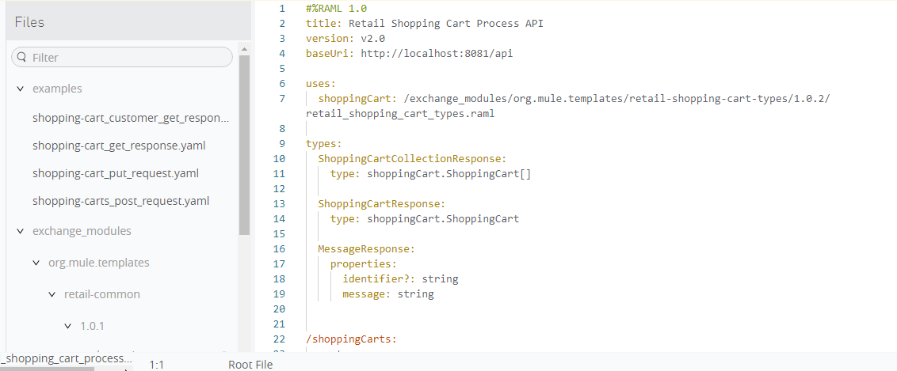
Design Specification - API

Slide 4
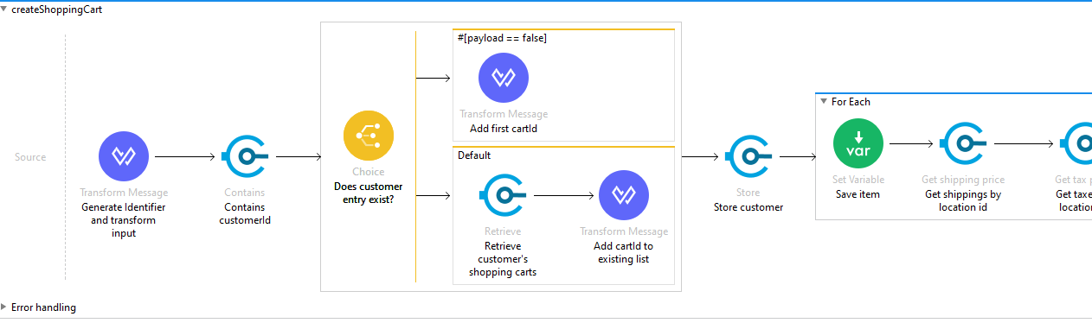
Implementation of the API

Slide 5
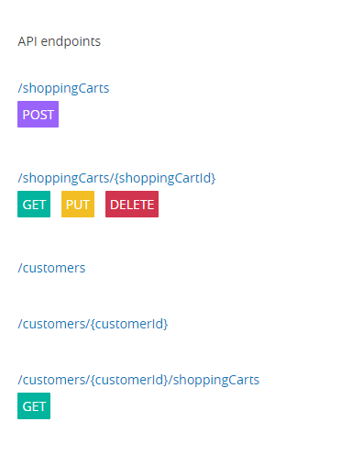
API specification for the shopping cart
With GET/POST/DELETE methods.

